Slide 1
Special Relativistic MHD for CANS+
自己紹介
氏名： 大村 匠 (九大D2)
研究分野：宇宙ジェット,MHD (CANS+ 歴4年目)
最近の興味：Radio-mode AGN feedback, Cosmic Ray,
Dynamics and Instability, Emission Mechanism
目的
CANS+に一般相対論効果を取り入れる。
成果
Riemann Solver : HLL, (HLLC：バグあり?)
Primitive Recovery : Mignone & Bodo (2006)
Wave speed Estimate : Leismann + (2005)
Coordinate: Cartesian gird, Cylindrical grid

Slide 2
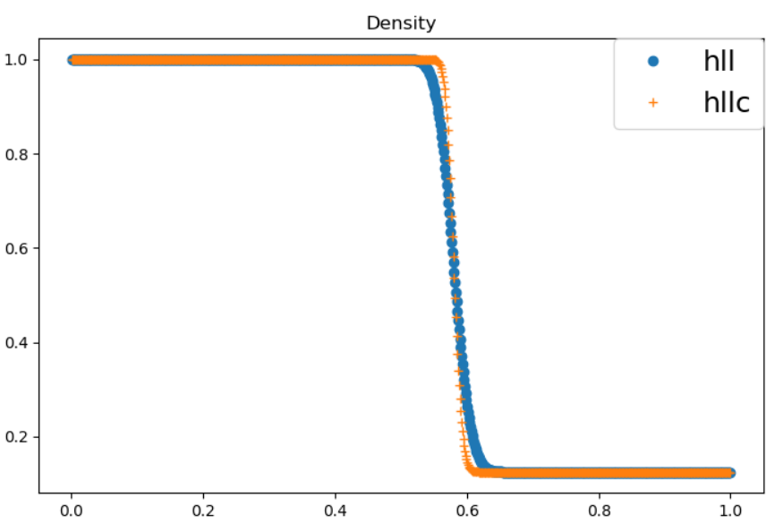
1D-Riemann Problem (HLLC vs. HLL)

Slide 3
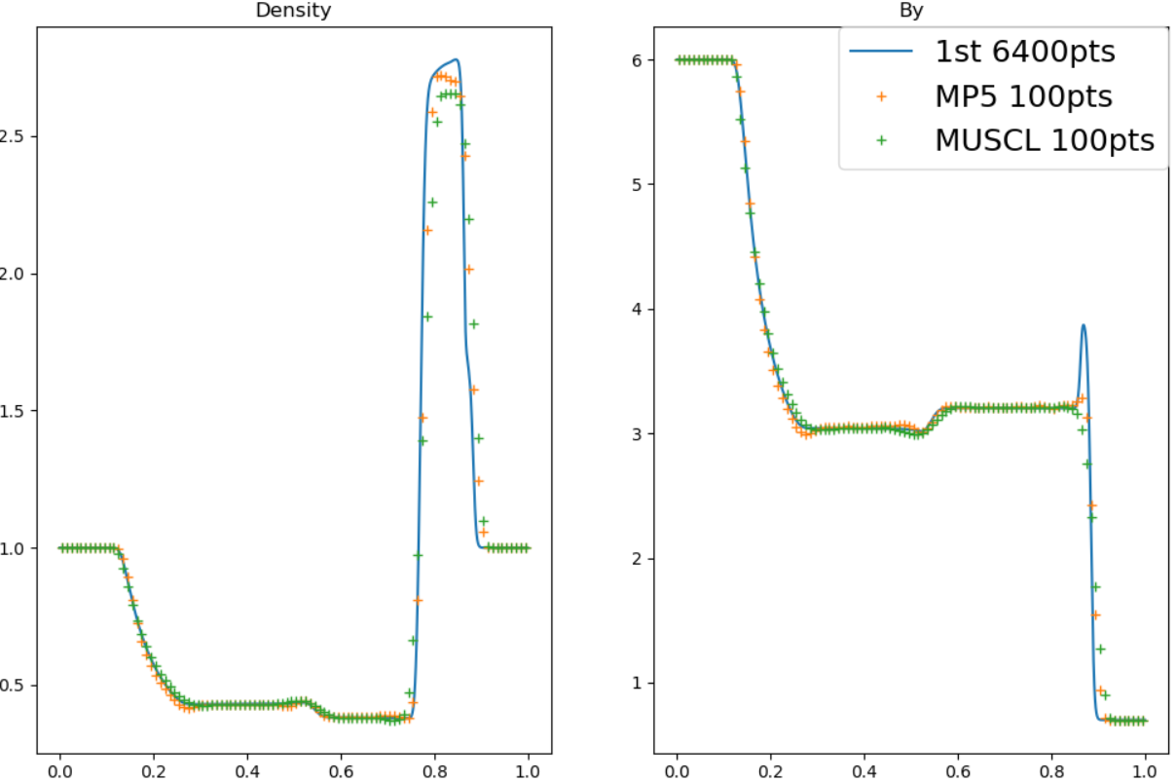
1D-Riemann Problem (MUSCL vs. MP5)

Slide 4
2D-Kelvin-Helmholtz unstable flows
$$\sqrt{B_{x}^{2}+B_{y}^{2}}/B_{z}$$
Method
-> HLL + 1st
Grids
-> (360,720)
:Setup:
Velocity shear
-0.25, 0.25
ρ = 1, P = 20
$$B_{x}=\sqrt{2×0.01p_{g}}$$
$B_{z}=\sqrt{2p_{g}}$
Bucciantini & Del Zanna (2006)

Slide 5
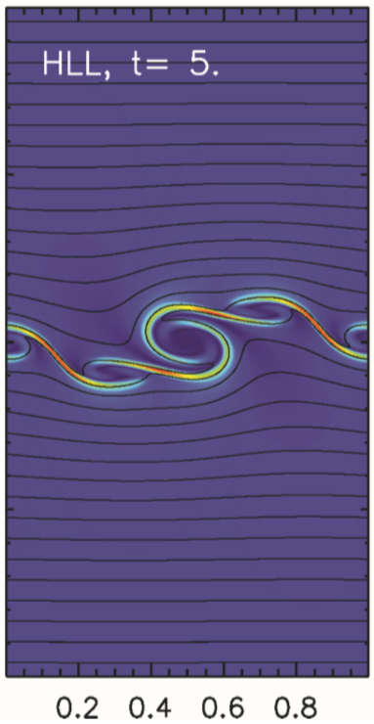
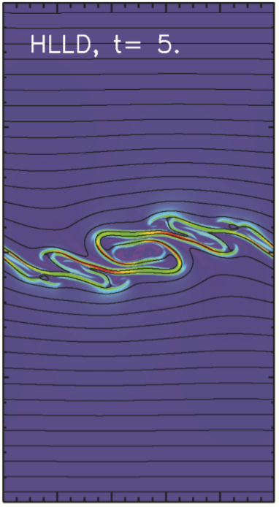
2D-Kelvin-Helmholtz unstable flows
空間3次精度
$$t=1.5$$
Mignone + (2006)
MUSCL(MCリミター), MP5では、計算がこけてしまった…

Slide 6
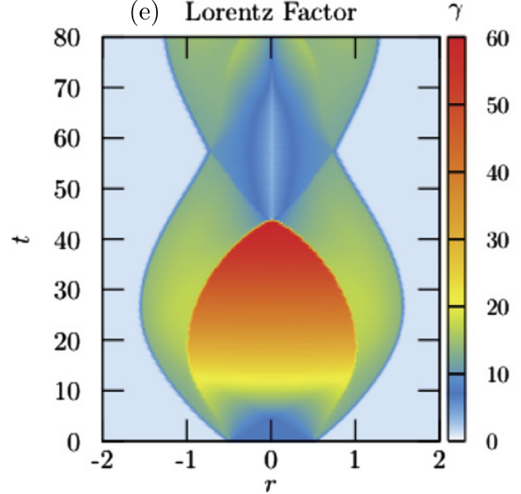
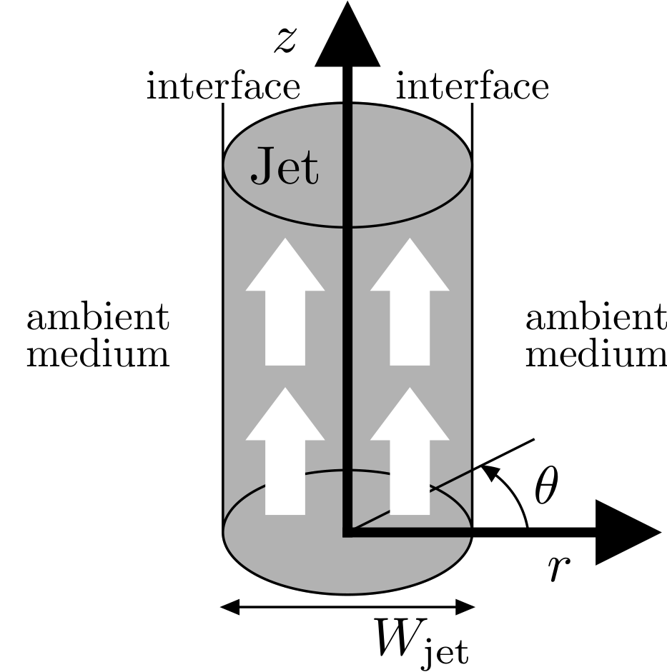
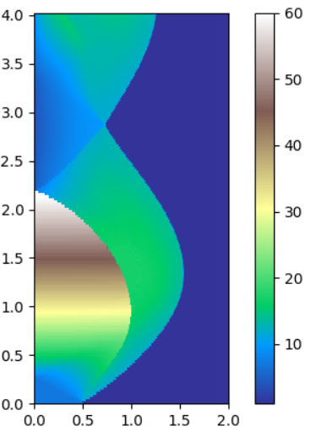
1D Hydrodynamic Steady Jets (Matsumoto+ 2012)
Matsumoto+：HLLD + MUSCL, 2000 grid
今回 : HLL+MP5, 3000 grid

Slide 7
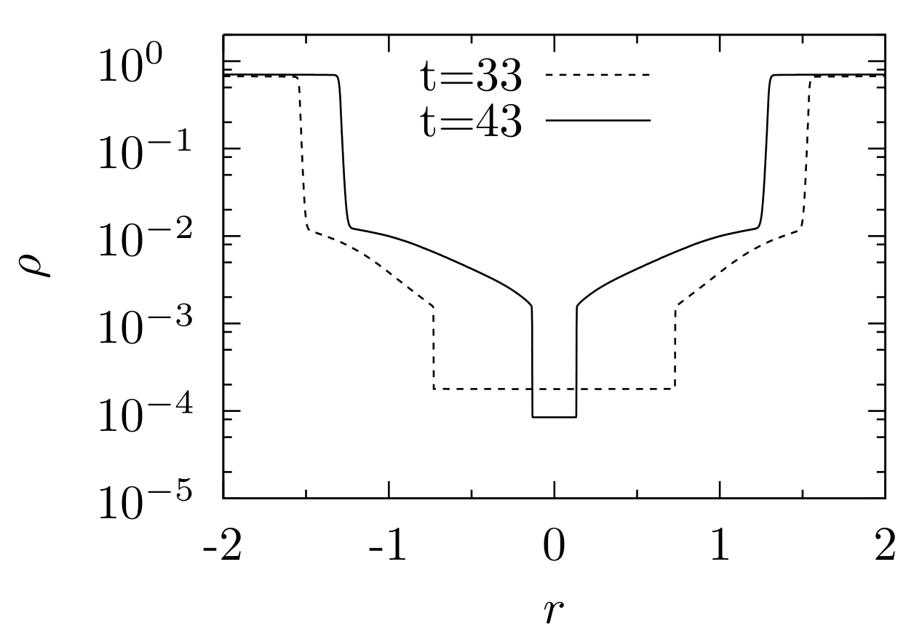
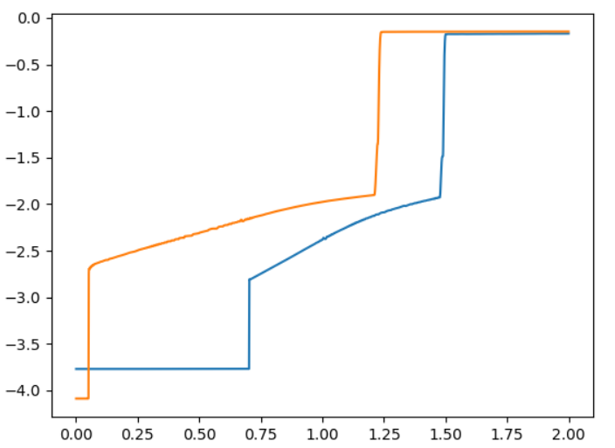
1D Hydrodynamic Steady Jets (Matsumoto+ 2012)
Matsumoto+：HLLD + MUSCL, 2000 grid
今回 : HLL+MP5, 3000 grid

