Slide 1
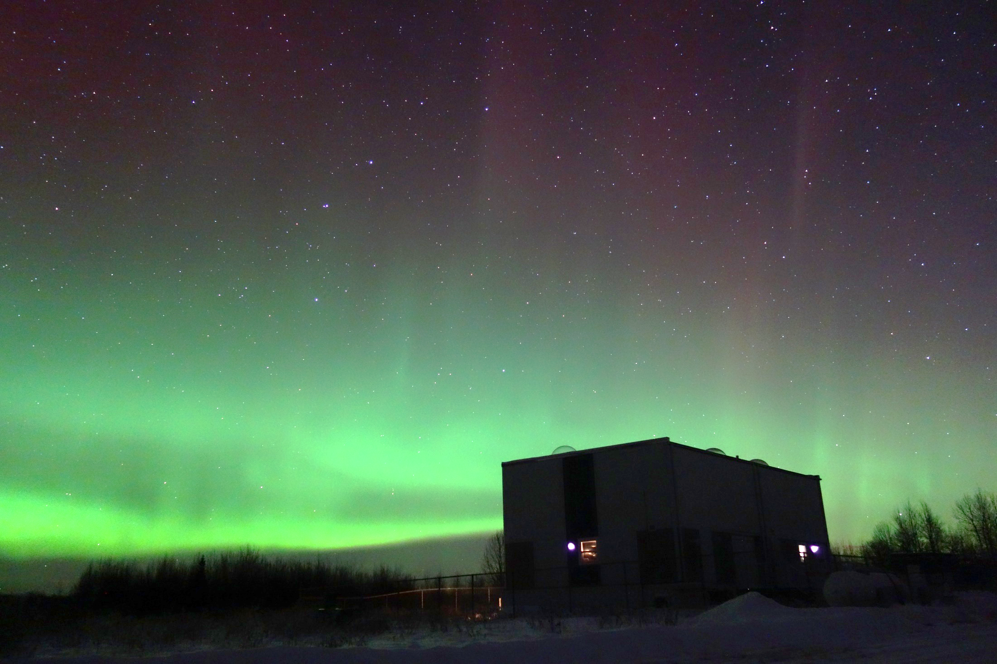
成果報告会
井上 智寛
金沢大学 大学院 M2 電子情報科学専攻
電波情報工学研究室
Notes:
Thank you Mr. Chairman.
Today, I’ll be talking about pulsating proton aurora and spiky CNA associated with Pc1 waves at sub-auroral latitude.

Slide 2
研究内容
磁気圏
地上同時観測
Pc1波動
波動粒子相互作用
脈動プロトンオーロラ
プラズマ波動 高エネルギーイオン
共鳴
( 数keV ~ 数十keV )
地上から
調査
波動粒子相互作用
磁力線に沿って
伝搬 ・ 降下
高エネルギーイオン
プラズマ波動
地上観測
Pc1波動
南
脈動プロトンオーロラ
地上リモートセンシング
Pc1波動と脈動プロトンオーロラを地上観測することで
宇宙電磁波環境の調査を行う
主な研究内容：動画像処理＋音声信号処理を用いた観測データの雑音除去
Notes:
EMIC waves cause pitch angle scattering of high-energy ions via wave-particle interaction.
Then precipitating particles cause pulsating proton aurora.
In order to understand the magnetospheric dynamics, we are studying pulsating proton aurora
Here, we refer to pulsating proton aurora as PPA.

Slide 3
高次精度の移流スキーム
RK-MP5
Notes:
EMIC waves cause pitch angle scattering of high-energy ions via wave-particle interaction.
Then precipitating particles cause pulsating proton aurora.
In order to understand the magnetospheric dynamics, we are studying pulsating proton aurora
Here, we refer to pulsating proton aurora as PPA.

Slide 4
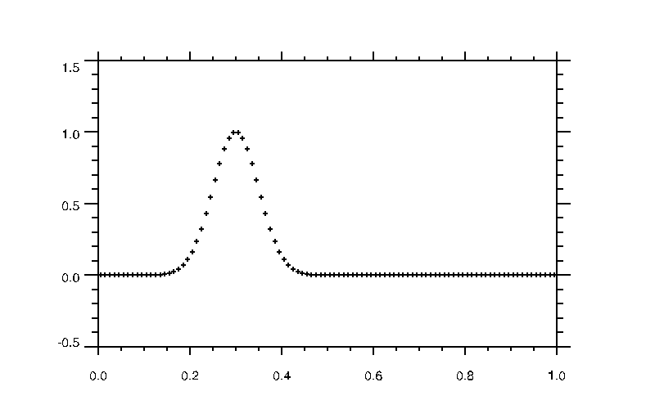
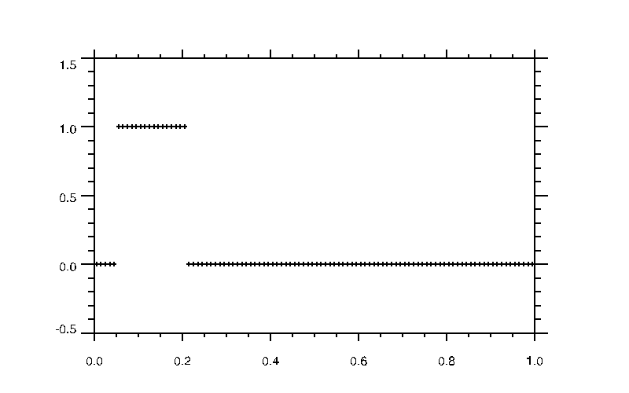
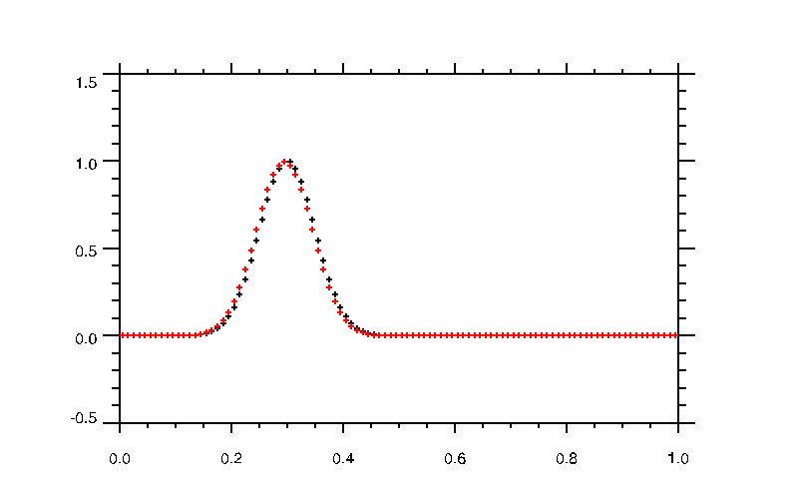
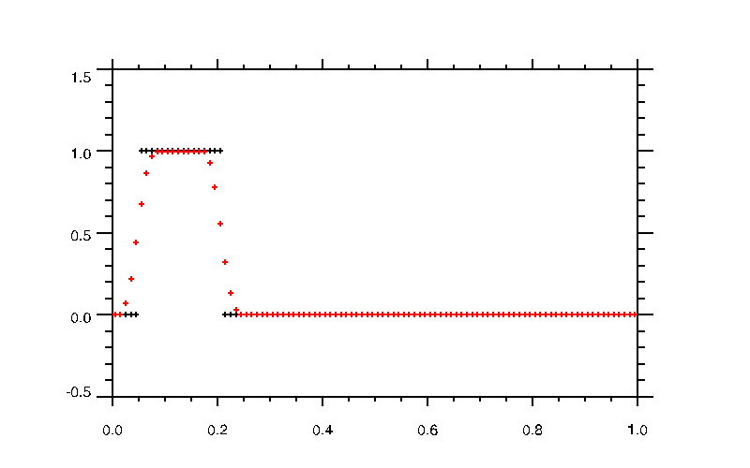
RK-MP5
初期と1周期後
初期と1周期後
Notes:
EMIC waves cause pitch angle scattering of high-energy ions via wave-particle interaction.
Then precipitating particles cause pulsating proton aurora.
In order to understand the magnetospheric dynamics, we are studying pulsating proton aurora
Here, we refer to pulsating proton aurora as PPA.

Slide 5
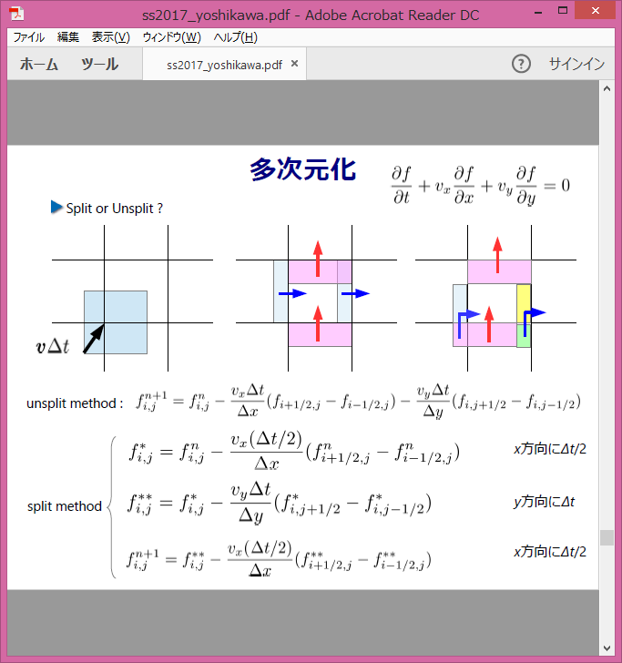
RK-MP5 スキーム 多次元化
Notes:
EMIC waves cause pitch angle scattering of high-energy ions via wave-particle interaction.
Then precipitating particles cause pulsating proton aurora.
In order to understand the magnetospheric dynamics, we are studying pulsating proton aurora
Here, we refer to pulsating proton aurora as PPA.

Slide 6
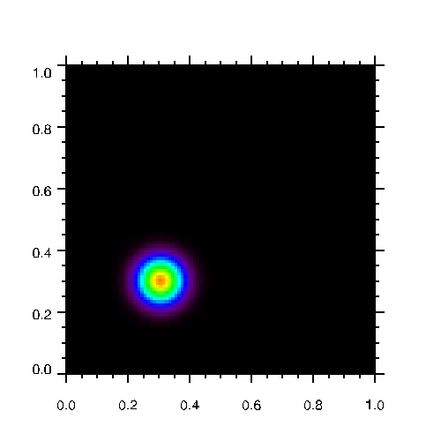
Rk-MP5 スキーム 多次元化
$$CFL=0.5$$
y
x
Notes:
EMIC waves cause pitch angle scattering of high-energy ions via wave-particle interaction.
Then precipitating particles cause pulsating proton aurora.
In order to understand the magnetospheric dynamics, we are studying pulsating proton aurora
Here, we refer to pulsating proton aurora as PPA.

Slide 7
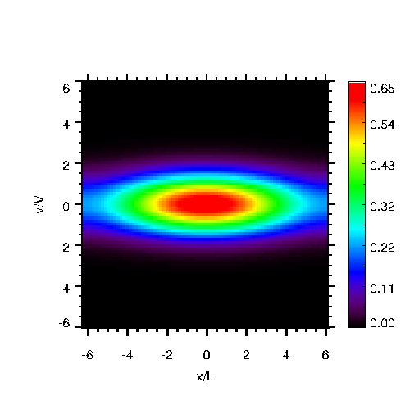
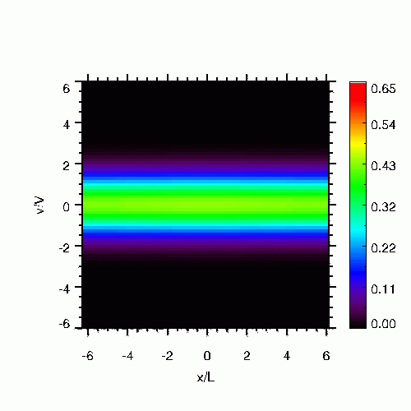
Landau Damping
Non-Linear Landau Damping
Linear Landau Damping
Notes:
EMIC waves cause pitch angle scattering of high-energy ions via wave-particle interaction.
Then precipitating particles cause pulsating proton aurora.
In order to understand the magnetospheric dynamics, we are studying pulsating proton aurora
Here, we refer to pulsating proton aurora as PPA.

