Slide 1
SS2015 report
Wang Shuoyang
2015/08/07

Slide 2
Purpose of simulation study
My study topic is magnetic reconnection (MHD regime)
→ observation (low resolution)
→ experiment (difficult to control)
→ numerical simulation (easy to develop)
MR requires delicate treatment
→ robust code is demanded

Slide 3
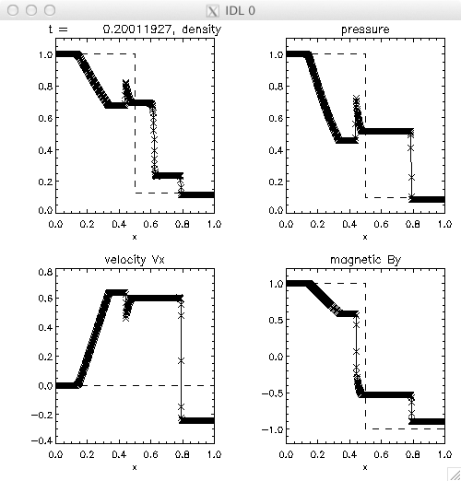
Simulation test I
1D MHD shock-tube problem
WENO3+HLLD+RK
$L_{x}=1, N_{x}=800$
$γ=2.0$
Free boundary condition
CFL condition:
$v_{c} \sim \max\left(v_{x}\right)+v_{f}$
t=0

Slide 4
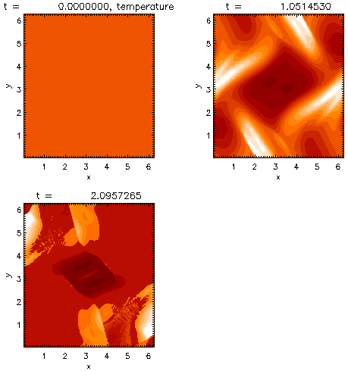
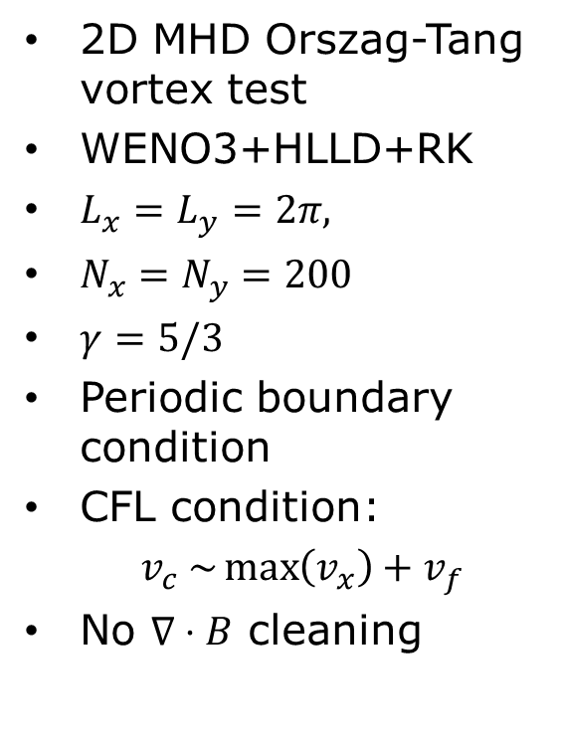
Simulation test II
2D MHD Orszag-Tang vortex test
WENO3+HLLD+RK
$L_{x}=L_{y}=2π,$
$N_{x}=N_{y}=200$
$γ=5/3$
Periodic boundary condition
CFL condition:
$v_{c} \sim \max\left(v_{x}\right)+v_{f}$
No $∇⋅B$ cleaning
simulation breaks

Slide 5
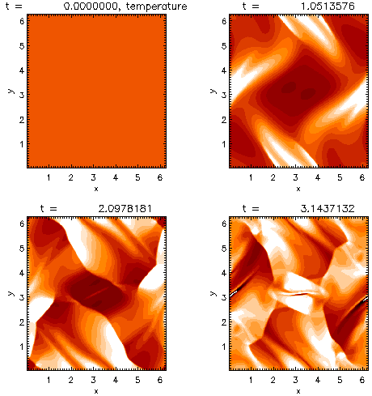
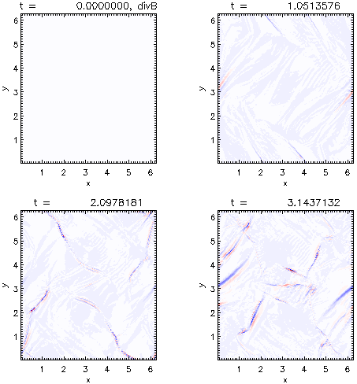
Simulation test II
$∇⋅B$ cleaning: 9-wave method → negative pressure appears
$$T≤1.5$$
$$\left|∇⋅B\right|≤0.005$$
if diffusion propagation speed is reduced, no negative pressure → needs further checking

Slide 6
Summary
$∇⋅B$ cleaning part still needs to be reconsidered (solve the negative pressure problem)
In the future, explicit diffusion term should be included to solve the magnetic reconnection proble

