Slide 1
Simulation SS2015 Report of Accomplishment and Progress
2015/08/07(FRI) @Chiba University
Department of Earth and Planetary Science, The University of Tokyo
Shunya Kono

Slide 2
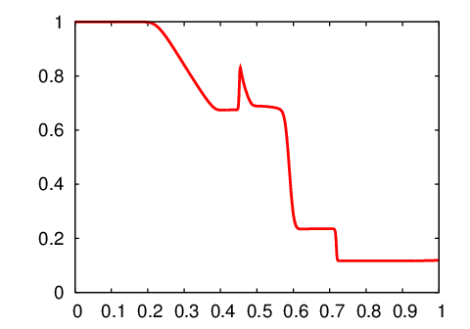
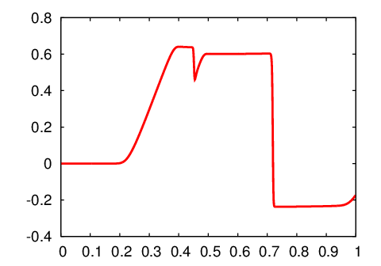
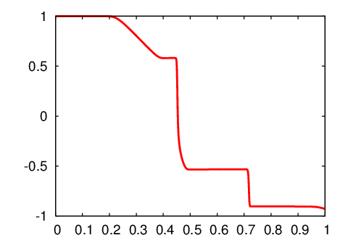
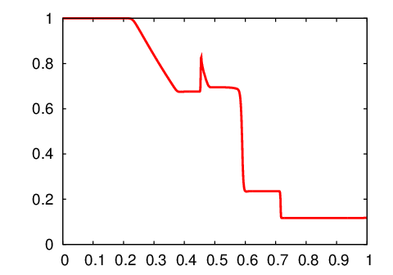
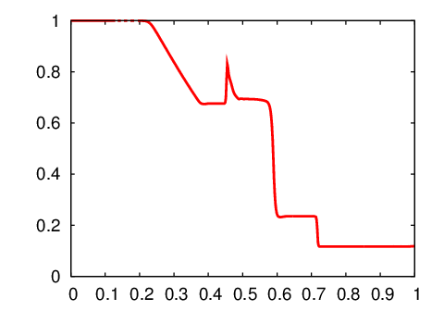
1. Accomplishment
HLLD Method for Solving MHD Equations
Shock tube problem
$$ρ$$
$$V_{x}$$
$$B_{y}$$
1st order
MUSCL-MM
WENO3

Slide 3
2. Progress
Application for 1.5D Simulation of Alfvén Wave
Alfvén waves are generated by convection motion and propagating in the solar atmosphere.
Alfven wave
Corona
Transition Region
$\frac{∂}{∂t}\left(ρS\right)+\frac{∂}{∂x}\left(ρV_{x}S\right)=0$
$\frac{∂}{∂t}\left(ρV_{x}S\right)+\frac{∂}{∂x}\left[\left(ρV_{x}^{2}+p+\frac{B_{y}^{2}}{8π}\right)S\right]=−ρgS+\left(p+\frac{B^{2}}{8π}\right)\frac{dS }{dx}$
$\frac{∂}{∂t}\left(ρV_{y}S\right)+\frac{∂}{∂x}\left[\left(ρV_{x}V_{y}−\frac{B_{x}B_{y}}{4π}\right)S\right]=A_{w}$
$\frac{∂}{∂t}\left(B_{y}S\right)+\frac{∂}{∂x}\left(E_{z}S\right)=0$
$\frac{∂}{∂t}\left[\left(\frac{p}{γ−1}+\frac{1}{2}ρV^{2}+\frac{B^{2}}{8π}\right)S\right]+\frac{∂}{∂x}\left[\left(\left(\frac{γ}{γ−1}p+\frac{1}{2}ρV^{2}\right)V_{x}+\frac{B_{y}E_{z}}{4π}\right)\right]=0$
$E_{z}=V_{x}B_{y}−V_{y}B_{x}$
Chromosphere
Photosphere
Convection Zone
$S$ : cross section

Slide 4
2. Progress
Application for 1.5D Simulation of Alfvén Wave
Investigate the nonlinear Alfvén wave propagation along a vertical open magnetic flux tube by using 1.5D MHD equations with gravity.
$\frac{∂}{∂t}\left(ρS\right)+\frac{∂}{∂x}\left(ρV_{x}S\right)=0$
$\frac{∂}{∂t}\left(ρV_{x}S\right)+\frac{∂}{∂x}\left[\left(ρV_{x}^{2}+p+\frac{B_{y}^{2}}{8π}\right)S\right]=−ρgS+\left(p+\frac{B^{2}}{8π}\right)\frac{dS }{dx}$
$\frac{∂}{∂t}\left(ρV_{y}S\right)+\frac{∂}{∂x}\left[\left(ρV_{x}V_{y}−\frac{B_{x}B_{y}}{4π}\right)S\right]=A_{w}$
$\frac{∂}{∂t}\left(B_{y}S\right)+\frac{∂}{∂x}\left(E_{z}S\right)=0$
$\frac{∂}{∂t}\left[\left(\frac{p}{γ−1}+\frac{1}{2}ρV^{2}+\frac{B^{2}}{8π}\right)S\right]+\frac{∂}{∂x}\left[\left(\left(\frac{γ}{γ−1}p+\frac{1}{2}ρV^{2}\right)V_{x}+\frac{B_{y}E_{z}}{4π}\right)\right]=0$
$E_{z}=V_{x}B_{y}−V_{y}B_{x}$
$$y$$
$$x$$
$S$ : cross section

Slide 5
2. Progress
Calculations with Different Scheme
Alfvénic pulse wave with frequency$=50$ mHz
Previous result (Modified Lax-Wendroff method + artificial viscosity)
→ Numerical oscillation appears.
Implementing HLLD method in the calculations.
→ couldn’t succeed...
→ try to remove the problem.

